Slide 1
Projet Web portail Fluo

Slide 2
Logo FLUO
Logo FLUO
Logos Tutelles
Services en ligne
Fr/En
Twitter
Menu > Laboratoire / Recherche / Ingénierie / Plateformes / Etudiants / Industriels / Grand public / Emploi
Champ Rech.
Présentation
presentation
presentation
Présentation
Presentation
Partenariat
Valorisation
Stages, thèses, post-docs
Direction
Nuclear Phy.
Instru & detect.
ALTO
Licenses
Instances
High energy
Mécanique
ANDROMEDE
Master
Offres emploi
Infos. Prat
Astro Cosmo
Electronique
SCALP
ED
Infos. Prat
Energy Environ.
Informatique
LASER X
Forma. Pro
Organigram.
Health physics
Theoretical Ph.
Accelerator Ph.

Slide 3
SNAPSHOT of the FUTURE LABORATORY
University researchers Professors Assistant Professors | 66 21 45 (13 HDR)
CNRS researchers “Directeurs de Recherche” “Chargés de Recherche” | 145 71 74 (29 HDR)
University Technical Staff (IT) | 22
CNRS Technical Staff (IT) “Ingénieurs de Recherche” “Ingénieurs d'Étude” “Assistants Ingénieur” “Techniciens” | 332 106 58 80 88
Postdoc | 38
Non permanent IT | 33
“Émérites” | 33
PhD | 102
TOTAL @ 1th april 2019 | 771
ALTO
ANDROMEDE
DU
2 DAJ
SCALP
Infrastructure
LaseriX
Communication/Evt
Radioprotection
Risk Prevention
Health
Physics
Quality
Nuclear
Physics
Astroparticle
And Cosmology
Energy and
Environment
Theoretical
Physics
Accelerator
Physics
Poles
High Energy
Physics
Engineering
Administration
Projet Management Office
Partenariat
Valorisation
DSA
DTA
DA
Education and knowledge transfer
Directorate : DU, DAJ, DSA, DTA, DA
DU = Directeur d’unite (Laboratory Director)
DAJ = Directeur Adjoint (Deputy Director)
DSA = Directeur Scientifique Associé (Scientific Associated Director)
DTA = Directeur Technique Associé (Technical Associated Director)
DA = Directeur Administratif (Administratif Director)
Library
SCIENCE :
SCIENTIFIC POLES

Slide 4
7 RESEARCH POLES
The ensemble of all the themes of “the physics of the two infinities” with the presence
of strong historical/existing poles, of emerging poles and of activities at the interfaces
NUCLEAR PHYSICS
~40
HIGH ENERGY PHYSICS
~50
ASTROPARTICLES & COSMOLOGY
~40
~50 postdoc
~100 PHD
ACCELERATOR PHYSICS
~30
ENERGY & ENVIRONNEMENT
~20
THEORETICAL PHYSICS
~40
HEALTH PHYSICS
~15

Slide 5
The scientific project overview and preliminary view
05/11/2019
Presentation FLUO - Tourniquet

Slide 6
Scientific
Pole
HIGH ENERGY
PHYSICS
Permanent : 47
PostDoc : 16
PHD : 28
Emerites : 9
New particles and symmetries beyond the Standard Model
Origin of the mass
Particle-antiparticle asymmetry
Particle Physics
Structure of nucleon (and of hadrons)
Medium effects
Quark Gluon Plasma
Hadronic Physics
Mixing matrix U_{PMNS} and CP violation in neutrinos
Masses and mass hierarchy of neutrinos
Nature of neutrinos (Majorana or Dirac)
Neutrinos
@accelerators/reactors
05/11/2019
Presentation FLUO - Tourniquet

Slide 7
Particle Physics
ATLAS
LHCb
ILC
Belle II
@ CERN, KEK
2018
2019
2020
2021
2024
2027
2030
2035
2040
ATLAS – Implication in HL-LHC with well structured and well financed national effort.
LHCb – Phase HL-LHC.
BELLE II – Implication in Phase 3 hardware (DAQ)
LHC
RUN2
RUN3
RUN4,5
LS2
LS3
Phase HL-LHC
4 ab−1 ultimate value
KEKB
Phase 2
Phase 3
Very well structured community worldwide.
Upgrade of the European Strategy on going (Summer 2020)
ILC
Ph 0
Construction/
Commissioning
DATA TAKING
ILC – Historical/strong implication. Waiting for decision
HE-LHC
LHeC, ep physics
FCC-hh, FCC-eh, FCC-ee
CLIC
Large effort for HL-LHC in detector construction phase (exploitation up to ~2035)
Contribution to BELLE II, developing activities in various domains
Important new positioning for future machines : conception and developments (ILC, HE-LHC, FCC, PERLE/LHeC…)
05/11/2019
Presentation FLUO - Tourniquet

Slide 8
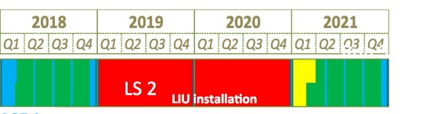


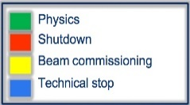
Hadronic Physics
JLab
EIC
LHCb-HI
FT
@LHC
HADES
@FAIR
@ Jlab , CERN,
GSI/FAIR
ALICE
LHCb Upgrade
(Phase 1)
SMOG2
LHCb Upgrade
(Phase 2)
Best estimate for the end of EIC construction : 2030
LHCb-SPIN
ALICE Upgrade
ALICE-FT with solid target?
Strong and visible presence at JLab. Opportunity of a strong impact on EIC (detector and accelerator /ERL)
Strong/complementary : ALICE (upgrades), LHCb-HI (upgrade)
Neutrinos
@accelerators/reactors
R&D LiquidO
SuperNEMO
@ LSM, LSC (Canfranc), Daya Bay, Mol, Fermilab
JUNO
DUNE
Soli∂
starting activities in JUNO. It Is the neutrino experiment at the short term
Increase the contribution in DUNE that should become the neutrino experiment at medium/long term.
Properly conclude Soli∂ and SuperNEMO
05/11/2019
Presentation FLUO - Tourniquet

Slide 9
Scientific
Pole
NUCLEAR
PHYSICS
Permanent : 37+1
PostDoc : 4
PHD : 17
Emerites : 4
Complexity of nuclear structure arise from the interaction among nucleons
Limits on nuclear stability
Production of chemical elements in the Universe
Properties of nuclei and strongly-interacting matter at high energies (shortly after the Big Bang, catastrophic cosmic events, compact stellar objects…)
Nuclear Physics
AstroNuclear
Physics
05/11/2019
Presentation FLUO - Tourniquet

Slide 10
Nuclear Physics
GANIL , ALTO, CERN-ISOLDE, FAIR-GSI, Riken, Jyväskylä, Argonne, LNG, Dubna…
Several Accelerator & beam developments
Several techniques mastered @Orsay
Several detector developpements :
hall 110 instrumentation at ALTO
BEDO, TETRA, POLAREX, LINO, MLL-Trap
ALTO ISOL-photofission
laser spectroscopy
neutron beams: LICORNE@ALTO
delayed/recoil spectroscopy
GRIT/MUGAST
GABRIELA@Dubna, S3-REGLIS@SPIRAL2
S3-LEB RIBs
particle and missing/invariant-mass spectroscopy
AGATA, OUPS
FAZIA
mass spectroscopy
prompt γ-spectroscopy
Success of SPIRAL2@GANIL. Further increase the impact of the Orsay community.
ALTO (upgrade) : focused on fundamental nuclear activities and platform opened to other disciplines and applications (health / radionuclides, material science, detector tests…).
05/11/2019
Presentation FLUO - Tourniquet

Slide 11
Scientific
Pole
ASTROPARTICLES
& COSMOLOGY
Permanent : 41+2
PostDoc : 16
PHD : 12
Emerites : 5
Gravitational waves : discovery and new astronomy
Multi-messenger astronomy : transient sky, acceleration mechanisms and dynamics of the violent Universe
Origin of the elements / nuclear processes at work in astrophysical sites
Matter in the stellar envelopes, journey in the interstellar medium, incorporation into protoplanetary disk
Fundamental tests of fundamental physics: (modified)Gravity, Lorentz Invariance.
Model of Primordial Universe. Improving knowledge of cosmological parameters; CMB
Search for (primordial) GW of inflation through CMB B modes
Elucidating the Dark Energy
Search for Dark Matter directly and indirectly : WIMPS, Dark Photons, Axions…
Neutrino Physics : masses, sterile neutrinos, interactions
Astroparticles
AstroNuclear/
Astro chemistry
Cosmology
Dark Matter
Neutrino
05/11/2019
Presentation FLUO - Tourniquet

Slide 12
Astroparticles
COCOTEAstroMeV
VIRGO/LIGO
@ Argentina (Auger), Spain (CTA), Italy/USA/Japan/India (GW detectors)
CTA
Auger
Compton CAM
SVOM
2018
2019
2020
2021
2022
2023
2024
2025
2026
2027
2028
2029
2030
Gravit. Waves
Advanced VIRGO
SVOM-construction
SVOM
Gamma Rays
CTA-construction
CTA
COCOTE/AstroMeV
e-AstroGAM
Cosmic Rays
Auger / Auger’
Decision on implications on LISA, ET, e-ASTROGAM
Gravitational waves and new positioning on future experiments (choice between ET and LISA)
Contribution to construction and exploitation of CTA
AstroNuclear / Astrochemistry
Strong links with person in Nuclear pole for the studies on production and properties of nuclei and different Nucleosynthesis processes (Alto-Tandem, GANIL, …)
Specificity/unicity on micrometeorites. Extraterrestrial material analysis (SCALP, Myrtho)
Dust evolution in the interstellar / interplanetary medium (ANDROMEDE, SCALP, Tandem, GANIL, …)
05/11/2019
Presentation FLUO - Tourniquet

Slide 13
Cosmology
SO
Simons Obs.
LiteBird
Bao-Radio/
21cm
@Chile (Simons Obs., LSST), Argentina (QUBIC), China (Tianlai), France (Nancay)
QUBIC
LSST
2018
2019
2020
2021
2022
2023
2024
2025
2026
2027
2028
2029
2030
QUBIC
CMB
SO-participation to analysis
LiteBird possible strart 2027
LiteBIRD-construction
LiteBIRD
LSST
LSST
Optical/Radio
BAO-Radio 21cm
Contribution to CMB studies and new positioning in future experiments : LiteBird.
Capitalised the participation to LSST construction contributing to the LSST exploitation
05/11/2019
Presentation FLUO - Tourniquet

Slide 14
(direct search) Dark Matter
XENON
EDEL
WEISS
DAMIC-1K
@ LNGS, LSM
2018
2019
2020
2021
2022
2023
2024
2025
2026
2027
2028
2029
2030
XENON
EDELWEISS
DAMIC-1K-construction
DAMIC-1K
Decision on DARWIN
Increasing contribution on XENON. Possible future positioning in DARWIN.
Neutrino (R&D cryo bolometers)
CUPID-Mo
Ricochet
@ LNGS, LSM
Important expertise on cryogenic scintillating bolometers. Intense and fruitful R&D. Links with Solid-State Physics team.
Transition/new positioning for 0ν2β searches. From NEMO to CUPID-Mo. Instrumental synergy with direct dark matter searches
05/11/2019
Presentation FLUO - Tourniquet

Slide 15
Scientific
Pole
HEALTH
PHYSICS
Permanent : 15+2
PostDoc : 2
PHD : 5
Emerites : 2
Biomedical imaging (earlier diagnosis, personalized treatment) . Radio-isotopical et optics
Radiotherapy (improve the TPS (treatment planning system) by developing new dosimetric approaches)
Modeling (understand and predict the evolution of complex biological systems)
ANDROMEDE : nanoparticle beams/mass spectrometer for surface analysis
PIMPA : non-linear multiphoton imaging for cellular and in vivo studies
SCALP/SIDONIE : electromagnetic separator for isotopic separation. Radionuclides
THOMX : intense and compact X-ray source
ALTO : to the production of new radionuclides
+ a biology service
Targeted radiotherapies: from the development of a dedicated dosimetry to the production of new radionuclides
Ambitious instrumental project: Participate to national and international initiatives of TOF-PET imaging (<100 ps)
Structure the activities of the platforms around a common biology service
05/11/2019
Presentation FLUO - Tourniquet

Slide 16
Scientific
Pole
ENERGY & ENVIRONNEMENT
Permanent : 20+1
PostDoc : 4
PHD : 12
Emerites : 2
Multidisciplinary approach of the theme to develop expertise benefitting teaching and research areas
Materials and ion irradiation (SCALP)
Radiochemistry (Laboratory 107)
Nuclear data (Virtual DATA grid)
Nuclear material
Physics of nuclear reactors and associated scenario (Virtual DATA grid)
Keep the diversity of the activities and increase the coherence of the pole in future projects.
Establishment of a predictive model of the storage concept for nuclear waste in the French geological storage site Cigeo
Robustness in scenario studies
Better understand the elementary mechanisms involved in solids under irradiation [nuclear (fission & fusion) and renewable energies applications]
05/11/2019
Presentation FLUO - Tourniquet

Slide 17
Scientific
Pole
THEORETICAL PHYSICS
Permanent : 36
PostDoc : 2
PHD : 13
Emerites : 10
Dark matter, neutrinos
Violents phenomena
Gravity
Biophysics
Dense matter
Complex systems
Nuclear - Hadronic - Particles AstroCosmo Math. Phys. Stat. Phys. Health Phys.
Links with experiences link to be developped (VIRGO,CTA…) links with IMNC exp. activities
Many nuclear exp.
LHC, Belle 2
Fixed target LHC, Jlab, EIC
Theory is transverse to FLUO with :
Many crossed interests among theorists
common interests with experimentalists
While preserving the necessary transversally and the very large spectrum of interests and applications
Reinforce and amplify the activities with strong links with experimental groups/poles/projects. Creation of strong clusters.
Theory and computing : Resources / Algorithmic / Big Data
05/11/2019
Presentation FLUO - Tourniquet

Slide 18
Scientific
Pole
ACCELERATOR PHYSICS
Permanent : 18+37
PostDoc : 8
PHD : 14
Emerites : 1
Researches on :
Acceleration, Laser and Applications
Physics, Instrumentation, beam handling
Vacuum Surfaces and Materials
RF
SPIRAL2, ATF, XFEL finished
ESS, ThomX on going (almost at the end)
Some activity in FCC
New positioning in Myrrha
Starting activities in DUNE-PIP-II
Very important axes for the future :
PERLE@Orsay ERL for future HEP/nuclear physics machines
LaseriX/PHIL R&D in laser/plasma with an HEP approach
Important role in developing and supporting platforms and for some of them to be associated to the researches
(balance and organisation to be finalised)
SCALP
ALTO
ANDROMEDE
Supratech
«Vacuum and Surfaces »
To increase the R&D activities in all of the themes of research. Some are still at the very beginning
Back to contribute to worldwide machines in one of our areas of excellence
Guarantee an efficient developing and operation of the complete set of local accelerator facilities of the new laboratory
05/11/2019
Presentation FLUO - Tourniquet

Slide 19
Les pôles scientifiques – les Directeurs Scientifiques Associés
Pôle Astroparticules et Cosmologie : Sophie Henrot-Versillé
Pôle Énergie et Environnement : Frederico Garrido
Pôle Physique des accélérateurs : Sébastien Bousson
Pôle Physique des Hautes Énergies : Marie Hélène Schune
Pôle Physique Nucléaire : David Verney
Pôle Physique Santé : Philippe Lanièce
Pôle Physique Théorique : Samuel Wallon
DEPUIS LE 23/10/2019, ces personnes ont la responsabilité de proposer un mode de fonctionnement des pôles dont elles ont la charge, en lien étroit avec les personnels concernés et en s’appuyant sur le travail fait lors de la phase projet.
Elles seront nommées Directeurs Scientifiques Associés (DSA) du pole début 2020. Leur nomination sera soumise au Conseil de Laboratoire pour avis.
05/11/2019
Presentation FLUO - Tourniquet

Slide 20
4 TECHNICAL DEPARTEMENTS
Strong pole of competences, essential pillars for the laboratory
to conceive, design and build the instruments.
ELECTRONICS
~60
INFORMATICS
~55
MECANICS
~55
Instrumentation
Detectors
~25
~30 non permanents

Slide 21
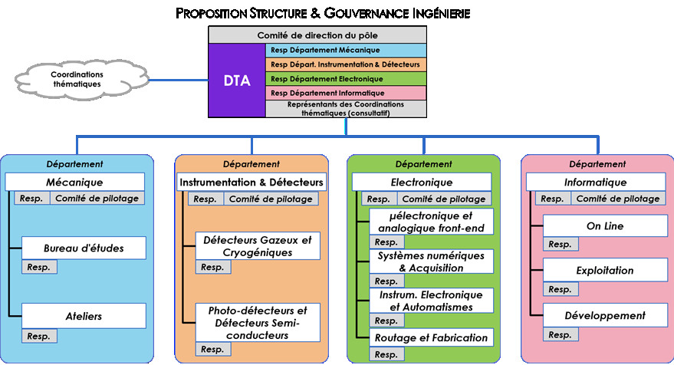
Pole of technical skills and expertise remarkable or unique
essential to the success of the scientific project
this many-skilled expertise is recognized nationally and internationally, and is an essential part of our contributions to projects
4 DEPARTEMENTS
11 SERVICES
FACTS. The disappearance of certain trades due to depleted manpower but also to the changes of the methods of work
4 départements
11 Services
(~55 people) (~23 people) (~61 people) (~53 people)
The creation of the new lab is an opportunity to preserve and amplify
The fact the technical services are fuelled by the challenges of the researches (R&D and Projects)
the proximity of the technical and research teams
the ability to combine and coexist versatility and specialization
The proposed organisation : The Services inside Departments are the elementary bricks of the “Engineering Pole”
05/11/2019
Presentation FLUO - Tourniquet

Slide 22
Le pôle ingénierie – les Responsables des Départements
Le directeur technique de ce pôle sera nommé par le DU à la suite d’un appel à candidatures et d’auditions. L’appel d’offre est sorti le 16/10/2019 (date de clôture des candidatures 13 Novembre 2019). Auditions et choix fin novembre
Le pole ingénierie sera construit avant la nomination du DT. Nous avons nommé 4 responsables de départements en leur donnant la tache de finaliser la construction de leur département en s’appuyant sur les personnels qui le constitueront
      Département mécanique : Christian Bourgeois
      Département détecteurs et instrumentation : Véronique Puill
      Département électronique : Eric Wanlin
      Département informatique : Michel Jouvin
Jusqu’à l’arrivée du DT, ces responsables constitueront la direction du pôle ingénierie.
Le DT dirigera ce pôle tel qu’il aura été défini et construit, en continuité du travail déjà mené par les responsables des départements
05/11/2019
Presentation FLUO - Tourniquet

Slide 23
Slide presentée en AG
KICK OFF de LANCEMENT en AG le 17/10/2019. Travail pour la structuration du pole ingénierie :
Organisation des départements et la finalisation des périmètres/nombre des services. Dans la phase projet (WP3) nous avons déjà identifié un certain nombre de « points non résolus ». Il est temps de les attaquer et d’arrêter les choix. Cela ne peut se faire qu’avec un travail collectif, dans un climat de dialogue et d’écoute
Nomination des chefs de service (par la direction). A la limite pas tous au même temps. Si certains départements ont plus rapidement que d’autres on procédera à certaines nominations plus rapidement. Une fois les chefs de services nommés, ils seront asssociés à la construction du departement
Pour permettre le positionnement de chacun dans les services, les responsables de département vont recevoir l'ensemble des personnes potentiellement concernées par le département .
Les chefs de département sont en train de rencontrer l’ensemble du personnel
05/11/2019
Presentation FLUO - Tourniquet

Slide 24
10 SUPPORT DIVISIONS/SERVICES
Indispensable in strongly and vitally supporting all the scientific and technical activities
Risk Prevention and Radioprotection
~10
ADMINISTRATION
~50
Events and Communication
~10
Infrastructure and Logistic
~10
Library and IST
Partnership
and Valorisation
Quality
Education and Knowledge Transfer
Project Management Office
~10
Cellule Ensegnement

Slide 25
Administration et support
Administration
Division Achat et Logistique : Virgine Quipourt
Division Financière : Marie-France Grandisson
Division RH et Accueil : Alexandre Henry
Service Marchés : Mohamed Adnane
Support
Division Infrastructure : Marc Langlet
Division Communication et évènements : Valérie Frois
Service de Prévention des Risques : Jean-François Le Du
Service Bibliothèque/IST : Sabine Starita
Service Coopération Internationale et Valorisation : Ketel Turzo et Souleymane Kamara
Service Qualité : Aurore Lermitage
Cellule de management de projet : Cynthia Vallerand
Cellule Enseignement : Catherine Bourge
Entretiens individuels avec l’ensemble des 90 agents concernés en septembre-octobre 2019 pour les aider à se positionner dans la nouvelle structure.
Les responsables sont en train d'organiser et de structurer les divisons/services/cellules en lien avec les personnels concernés
05/11/2019
Presentation FLUO - Tourniquet

Slide 26


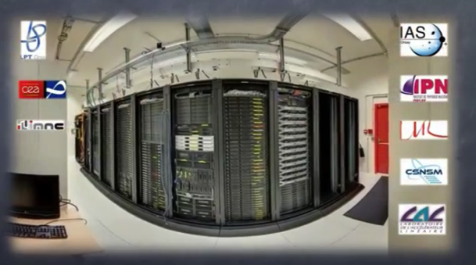




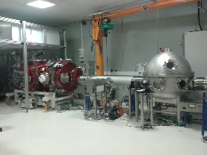
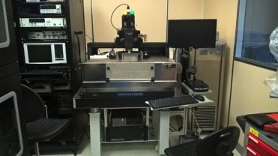
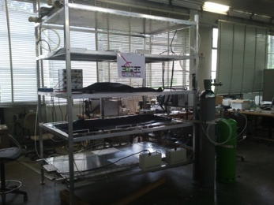
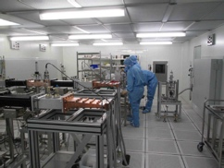
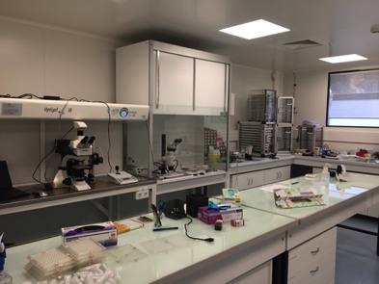


~50
The Platforms
Richness of FLUO for the sciences and for supporting the construction of detectors and accelerators
Ion Beam facilities
Xrays/electrons beams facilities
Intense compact X-ray source based on Compton effect
Technological demonstrator
Test bench for Detector characterization
Cavities for the Lock of
Advanced Virgo
interaction solid target – laser IR ⇒ plasma synchronous IR and XUV light beams
ultra short pluse (500 ps → 40 fs)
CALVA
Captinov
CORTO
Virtual Data
. shared hosting place with common infrastructure
Accelerator
Physics & Technology
micrometeorite
Preparation/analysis
Myrtho
SUPRATech
Power coupler station
γ detectors
development / characterization
spectroscopy / scanning
Labelized “in vivo imaging platform”
by FLI (France Life Infrastructure)
cryogenic infrastructure
cavities and modules preparation
non linear optical biphotonique imaging
(spatial, temporal, spectral)
to integrate “vide & surfaces”

Slide 27
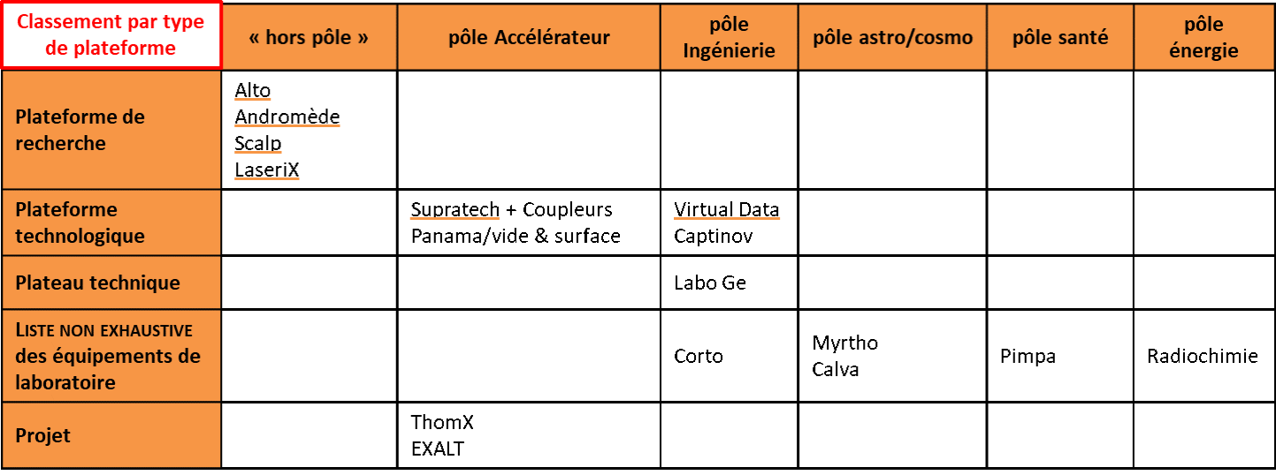
PLATFORMS
The platforms, at the service of the science developed in the laboratory, occupy an important place and have an important national or even international dimension.
The research platforms will not belong to any pole and will be directly attached to the direction.
As for the technological platforms they serve a laboratory (and beyond) strategy.
Few observations and key points :
find a good balance between research - exploitation - R&D - developments for users (+ economical model)
Play important role on teaching activities
Create a pool of common expertise to improve complementarities
05/11/2019
Presentation FLUO - Tourniquet

Slide 28
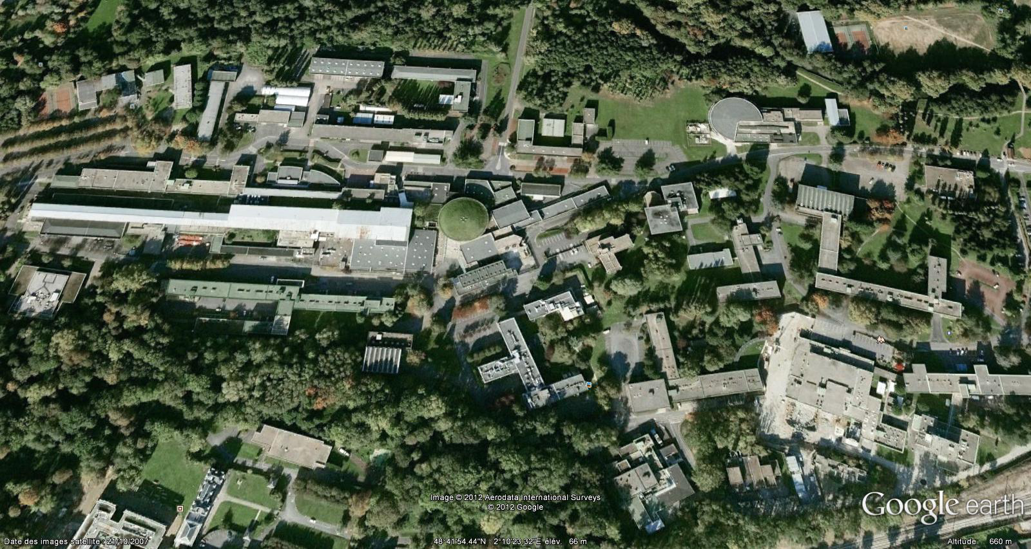
ABSOLUMENT crucial : un nouveau laboratoire restructuré dans un nouveau Campus
Support de 20.7M€
Obtenu en 2015 (CPER 2015-2020)
205
208
ALTO
Virtual DATA
109
Mecanical
Workshop
209
Plusieurs opérations :
Dôme IGLEX,
Virtual DATA,
Pôle Santé (Déménagement IMNC + emménagement pole sante au bat 104),
Pôle de physique théorique,
Atelier sur le vide et les surfaces, SupraTech,
Ateliers mécaniques,
Plateformes SCALP,
Rénovation de bâtiments ....
Tecaching Building
Vacuum/Surface
Worskshop
Mecanical
Workshop
200
Science
ACO
PHIL/LaseriX
IGLEX
SCALP
108
100
210
104
102
Health
150 m
Supra Tech
103
On going / soon starting Operations
106
150 m
Depuis 2018 cela marche à pleine vitesse. La Vallée P2IO est en chantier !
  6,077M€ déjà dépensés / engagés , soit 29,4% de la somme totale
  8 MOe travaillent (bientôt 9)
Dernières dépenses prévues /permises pour l’été 2021
05/11/2019
Presentation FLUO - Tourniquet

Slide 29
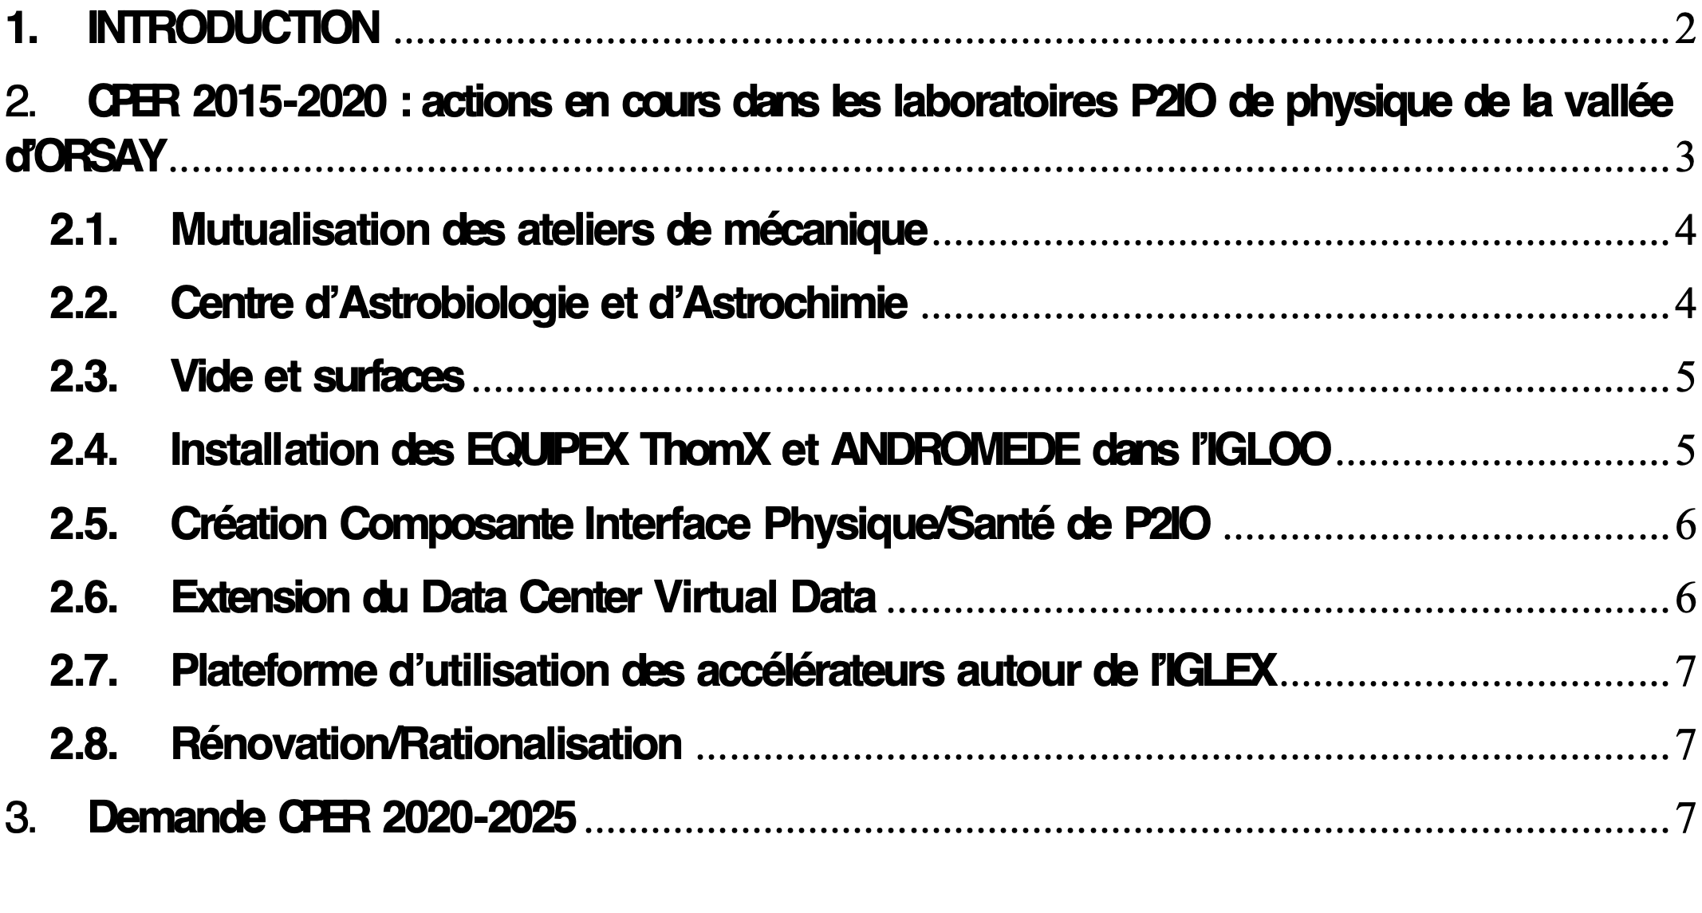
Priorité absolue pour le nouveau laboratoire
Orsay 6 Septembre 2019
LA PHYSIQUE DES DEUX INFINS DANS LA VALLEE D’ORSAY.
LE PROJET D’IMPLEMENTATION DU LABORATOIRE FLUO DANS LE CAMPUS D’ORSAY DE L’UNIVERSITE PARIS-SACLAY.
Demande de financement dans le cadre du CPER 2020-2025
CPER 2021-2026 :
P2IO-Vallée 2.0. !
(Implémentation de FLUO)
support cible 31,5M€
3 piliers pour le nouveau CPER :
Rénovation/restructuration. Améliorer l'environnement et la qualité de vie (totem, cafétéria, entrées, ergonomie des bureaux...). Nouvel urbanisme de la Vallée, bâtiments, liens, sentiers : 14M€
Bâtiments neufs/réaménagés pour la mise en place d'équipements de recherche : 11,5M€.
Bâtiment dans la vallée entièrement dédié aux activités pédagogiques (bat 206) : 6M€
PROJET SOUMIS ET PRIORITAIRE POUR LE CNRS et L’UNIVERSITE PARIS-SACLAY
05/11/2019
Presentation FLUO - Tourniquet

Slide 30
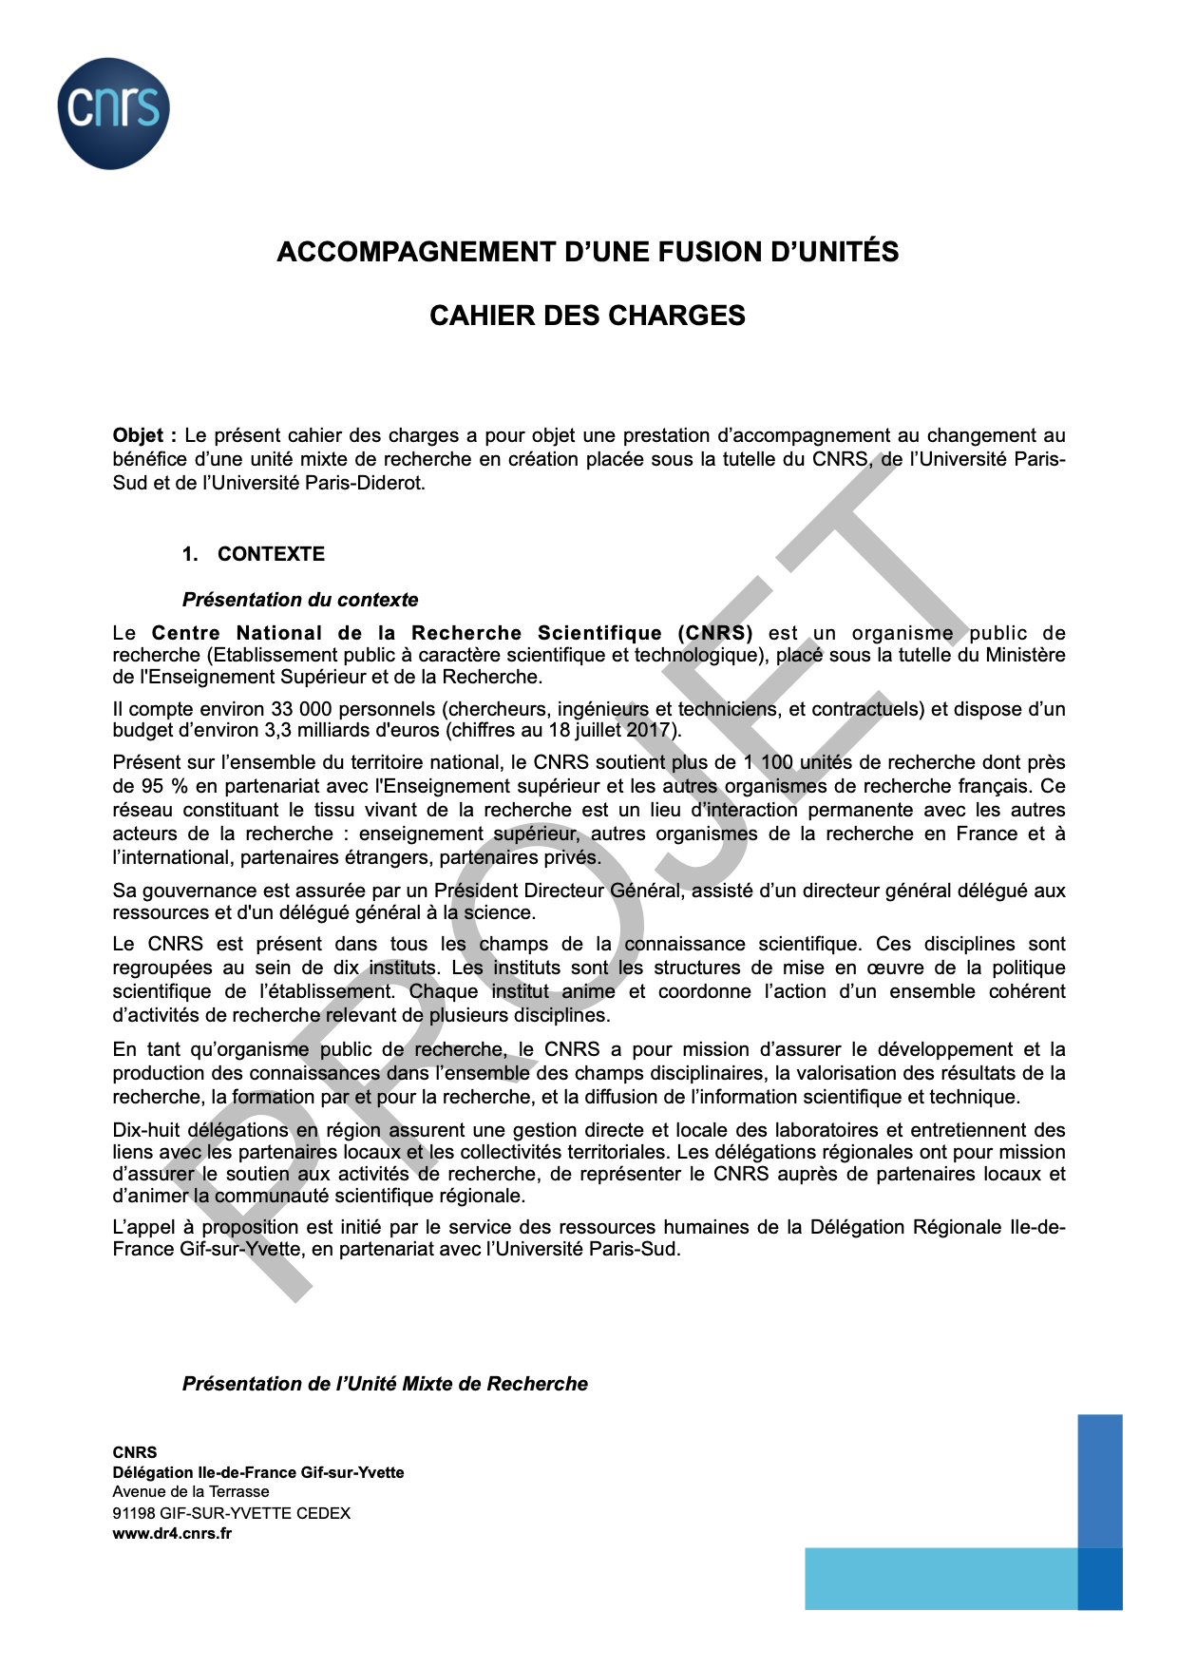
Accompagnement RH
Une partie de ce programme effectué en interne
Mais nécessité d’un intervenant extérieur
Elaboration d’un cahier des charges en lien avec la DR4
Réunion le 3/7/19 avec DUs des laboratoires, DR4, tutelles
  Accord des présents sur la nécessité d’un financement
  Transmission par la DR4 d’une demande de financement auprès de la DRH du CNRS
  refus initial signifié en août
Déblocage de la situation en octobre:
  acceptation d’un financement par la DRH du CNRS
  financements supplémentaires de la DR4 et de l’IN2P3
  modification de l’appel d’offre pour insister sur accompagnement RH à partir de janvier 2020
Appel d’offre lancé par le CNRS à partir du 24 octobre
Sélection d’un prestataire d’ici fin novembre
05/11/2019
Presentation FLUO - Tourniquet

Slide 31
16/07/2019 Choix du directeur
13/09/2019 EAOM
18/09/2019 Assemblée Générale des tutelles Lancement phase d’ implémentation
11/09/2019 Prise de service de la Secrétaire Générale
20/09/2019 Nomination des directeurs adjoints
30/09/2019 AG Services Supports et Administration. Lancement et nomination chef de divisions
08 /10 / 2019 Conseil interlaboratoires FLUO
10/10/2019 AG Pole Ingénierie.
Lancement et nomination chef de département
17/10/2019 Nomination chefs des Pôles scientifiques
Réunions hebdomadaires
avec les DSA et le chefs départements
05-08/11/2019 Tourniquet
07/11/2019 CHCST UFR Sciences
19/11/2019 CRHCST DR4
18 /11 / 2019 Assemblée Générale des tutelles
22 /11 / 2019 Assemblée Générale FLUO
26 /11 / 2019 Conseil interlaboratoires FLUO
12 /12 /2019 Assemblée Générale FLUO
17 /12 / 2019 Conseil interlaboratoires FLUO
~27/11/2019 Auditions du Directeur Technique
1 Janvier 2020. Création de FLUO et début d’un mandat de construction
05/11/2019
Présentation FLUO - Tourniquet

